Slide 1
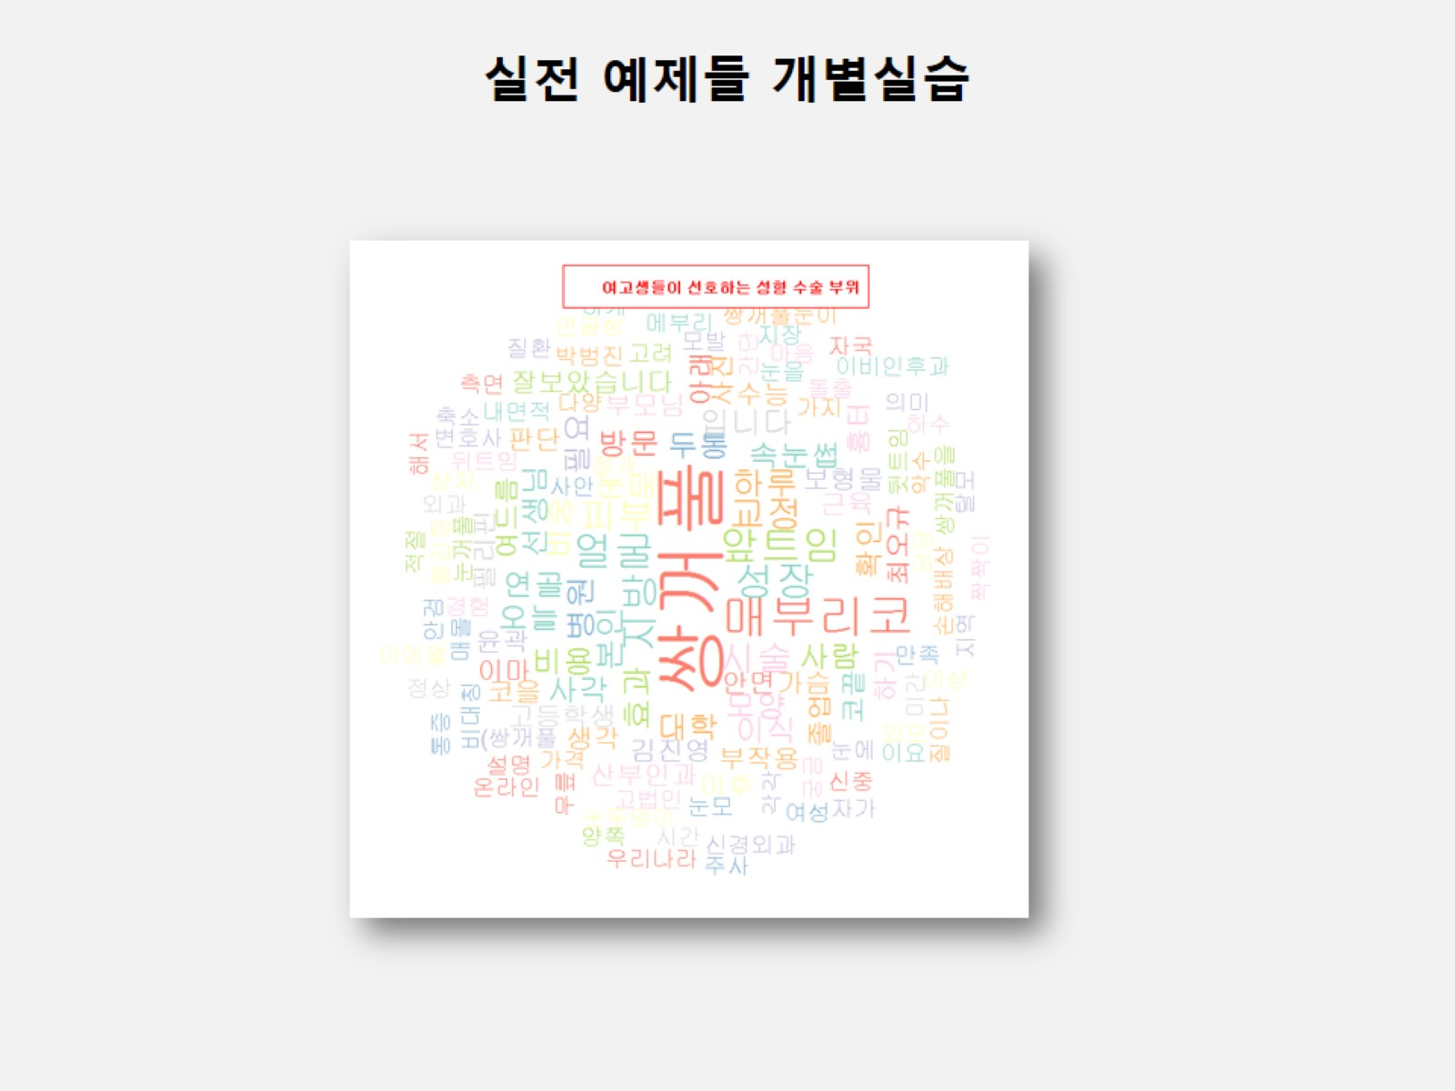

Slide 2
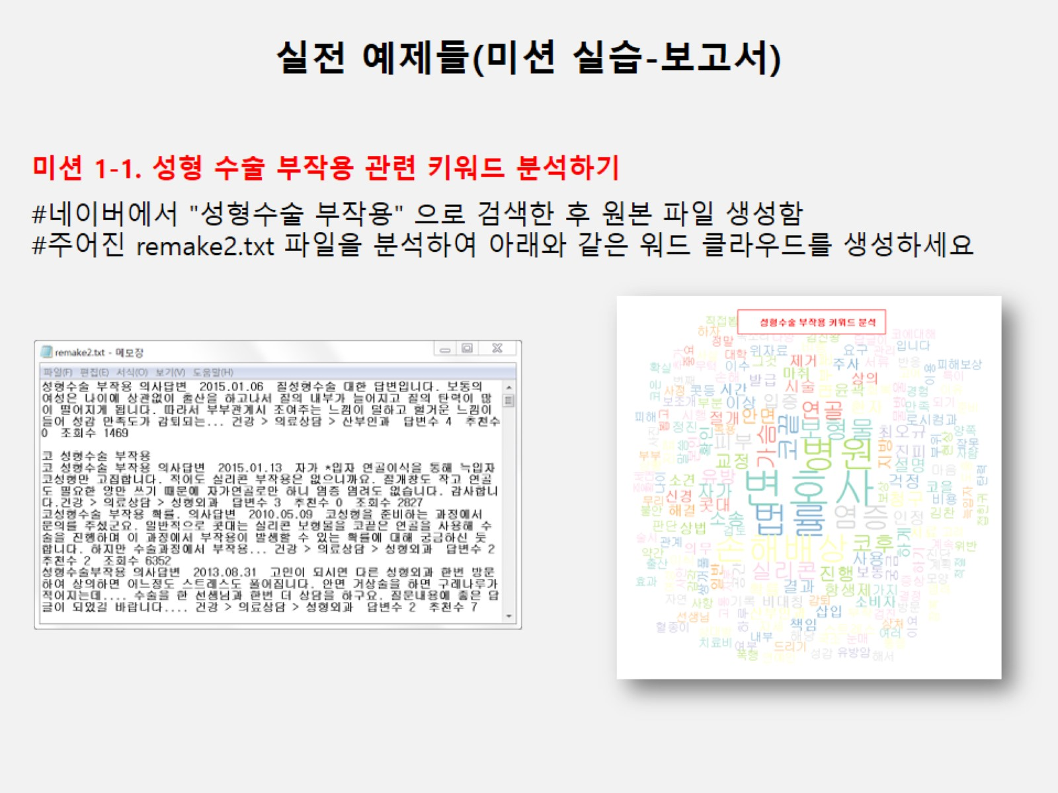

Slide 3
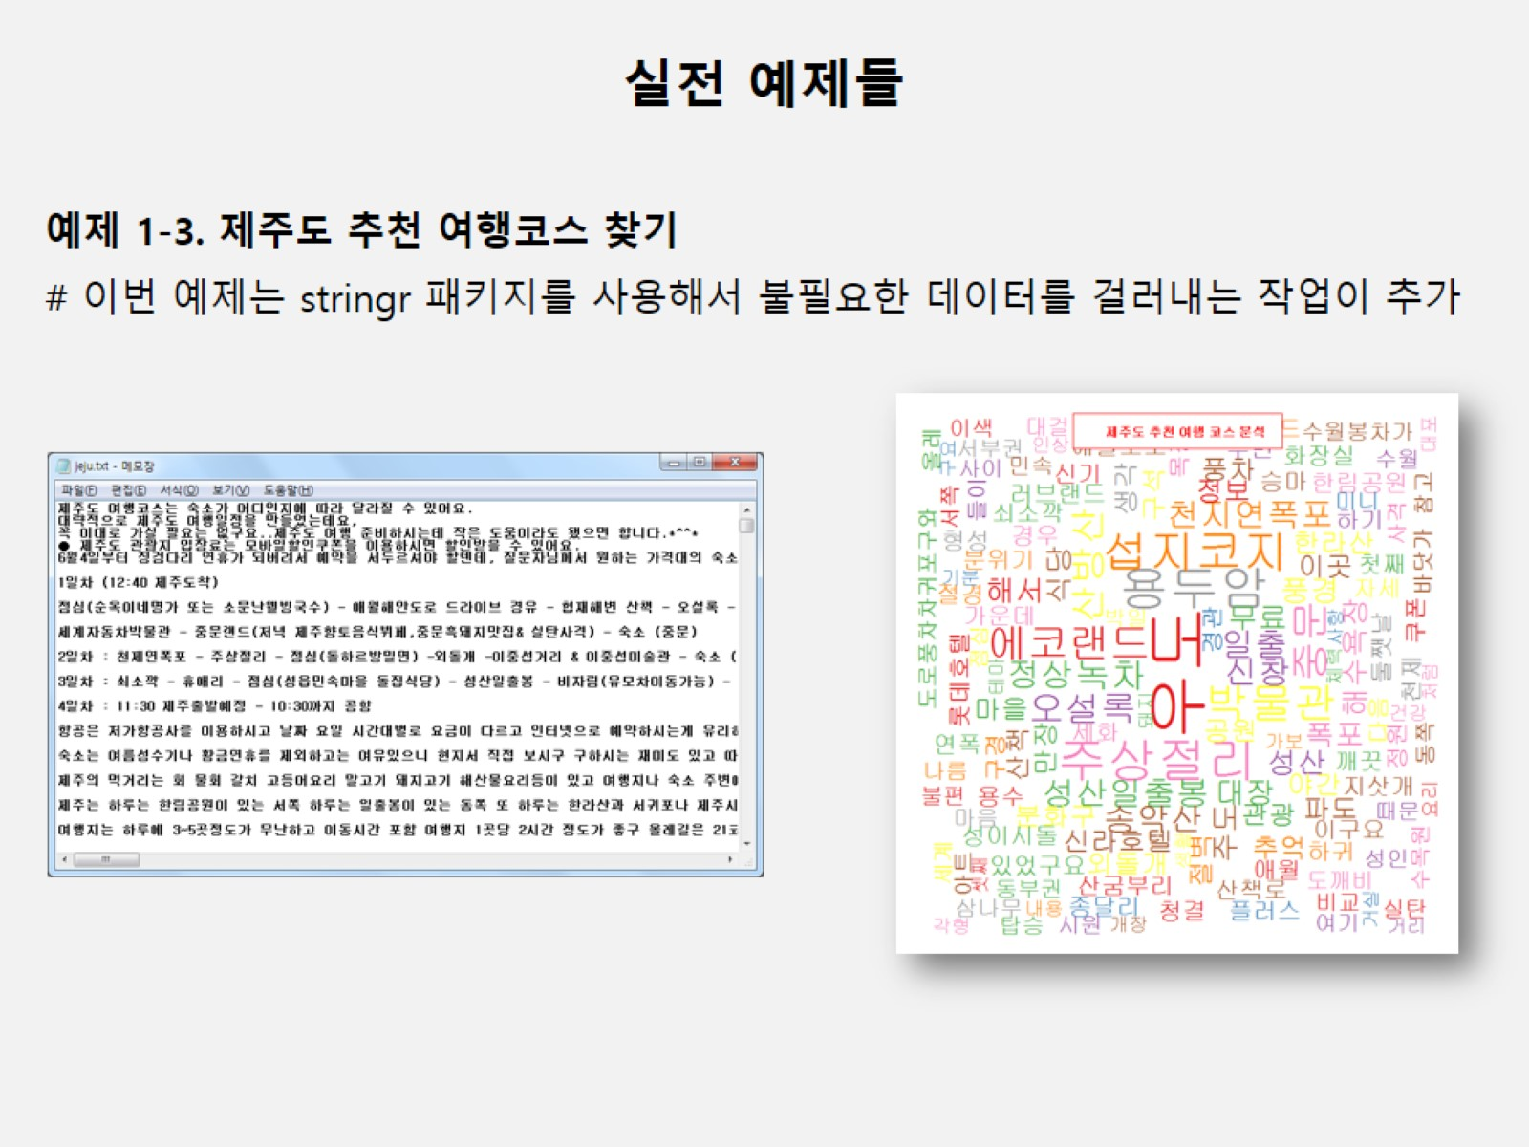

Slide 4
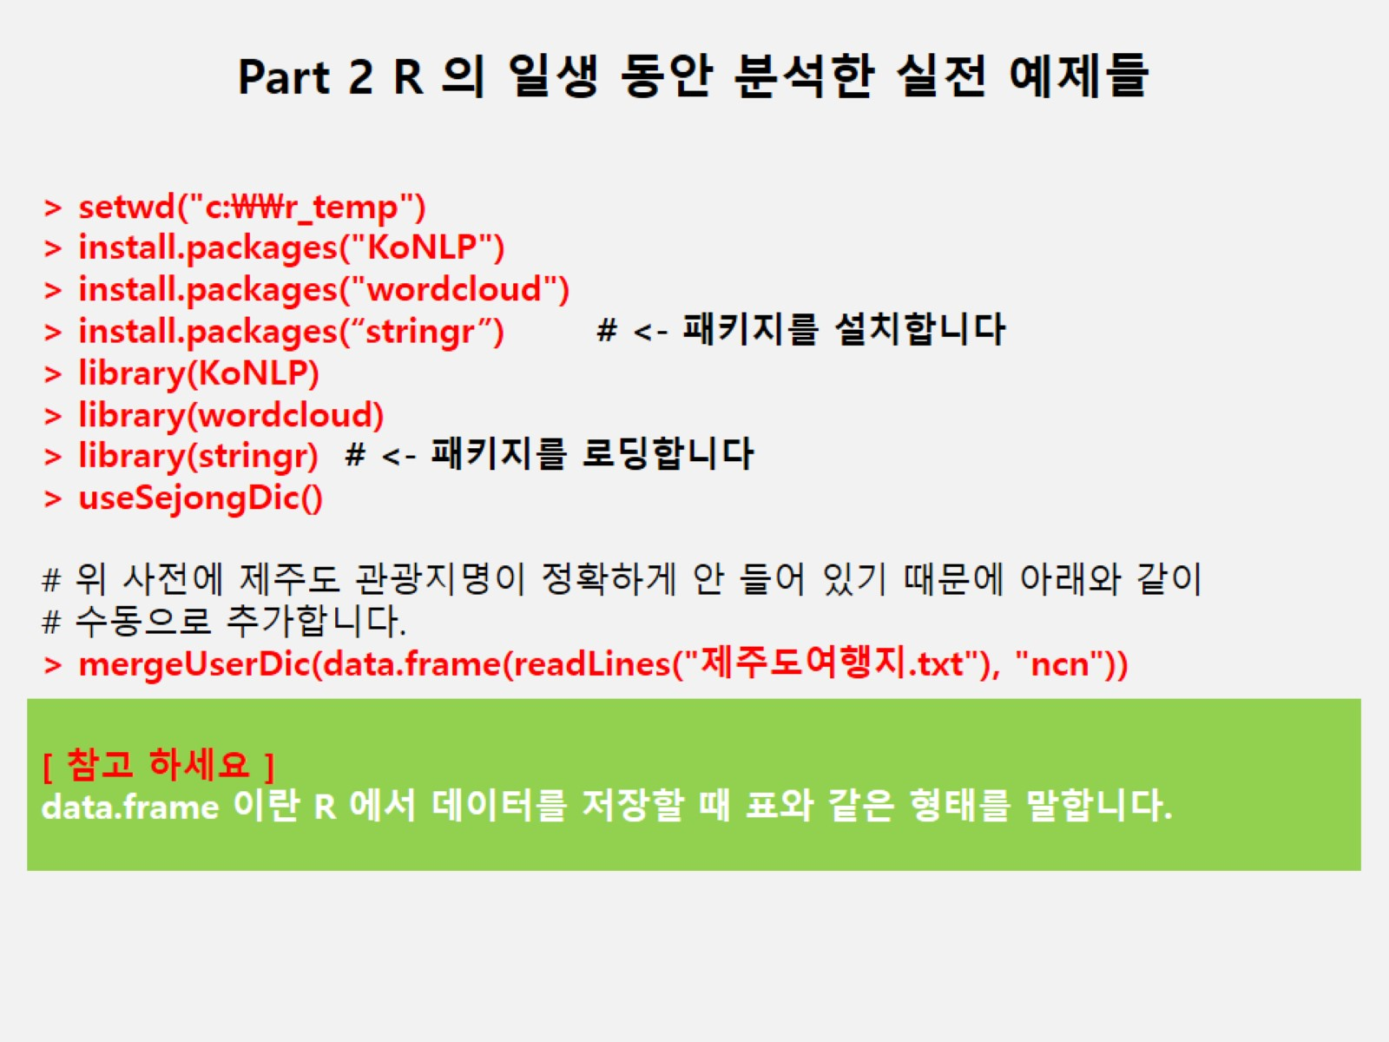

Slide 5
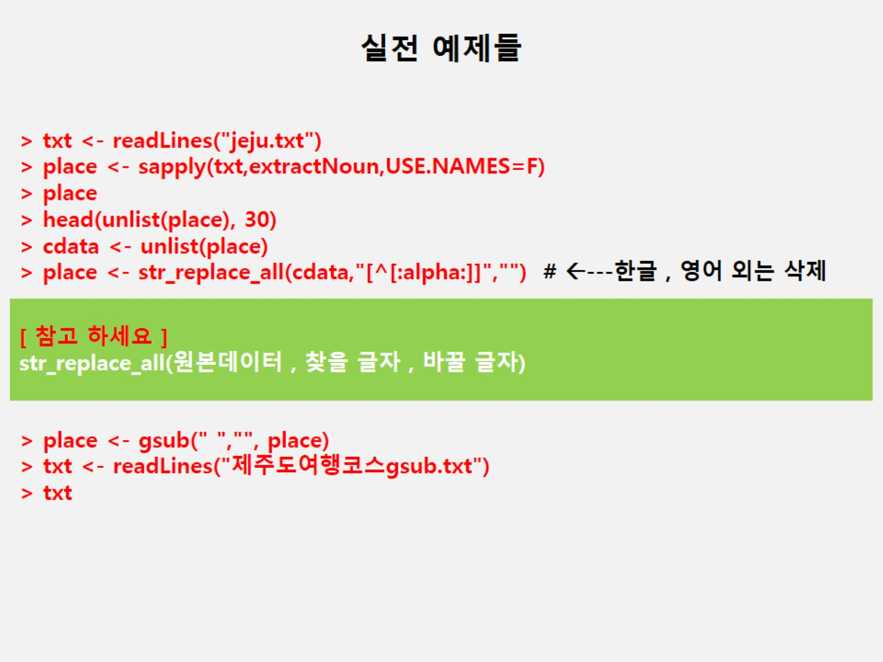

Slide 6
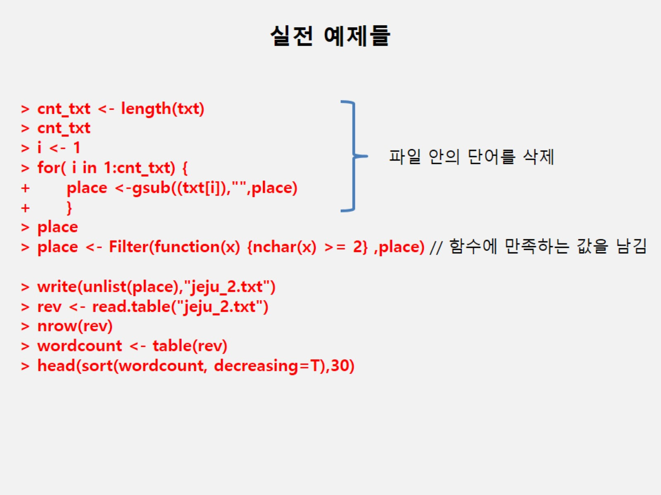

Slide 7
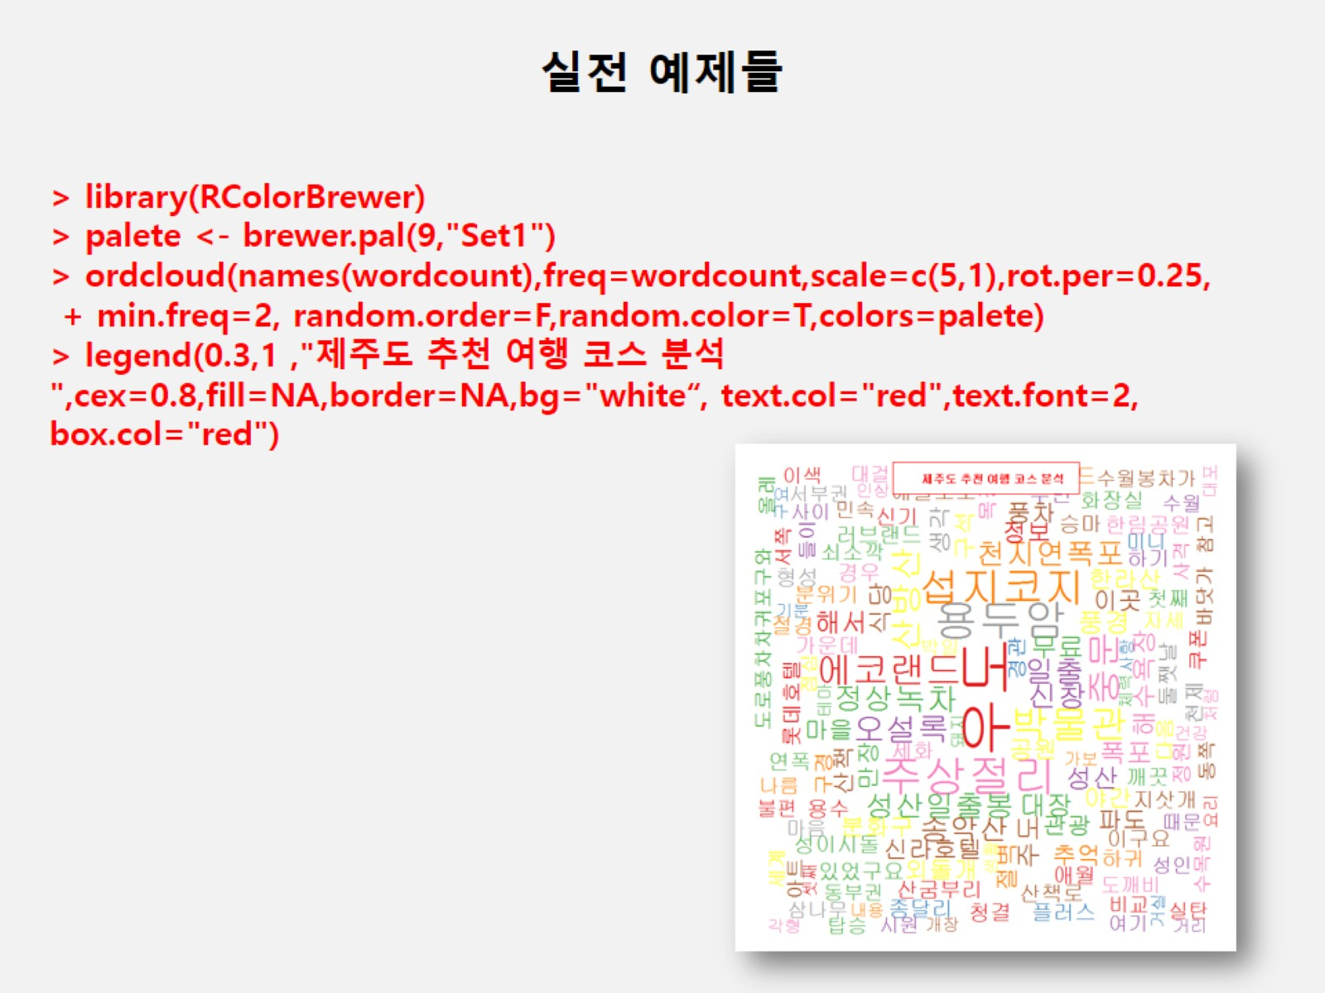
Notes:
setwd("c:\\easy_r")
install.packages("KoNLP")
install.packages("wordcloud")
install.packages("stringr")
library(KoNLP)
library(wordcloud)
library(stringr)
useSejongDic()
mergeUserDic(data.frame(readLines("제주도여행지.txt"),"ncn"))
txt<-readLines("jeju.txt")
place<-sapply(txt,extractNoun,USE.NAMES = F)
place
head(unlist(place),30)
cdata<-unlist(place)
place<-str_replace_all(cdata,"[^[:alpha:]]","")
place<-gsub(" ","",place)
txt<-readLines("제주도여행코스gsub.txt")
txt
cnt_txt<-length(txt)
cnt_txt
i<-1
for(i in 1:cnt_txt){
place<-gsub((txt[i]),"",place)
}
place
place<-Filter(function(x){nchar(x)>=2},place)
write(unlist(place),"jeju_2.txt")
rev<-read.table("jeju_2.txt")
nrow(rev)
wordcount<-table(rev)
head(sort(wordcount,decreasing = T),30)
library(RColorBrewer)
palete<-brewer.pal(9,"Set1")
wordcloud(names(wordcount),freq=wordcount,scale=c(5,1),rot.per = 0.25,min.freq=2,random.order = F,random.color=T,colors=palete)
legend(0.3,1, "제주도 추천 여행 코스 분석",cex=0.8,fill=NA,border=NA,bg="white",text.col="red",text.font=2,box.col="red")

Slide 8
제주도 여행지
setwd("c:\\easy_r")
install.packages("KoNLP")
install.packages("wordcloud")
install.packages("stringr")
library(KoNLP)
library(wordcloud)
library(stringr)
useSejongDic()
mergeUserDic(data.frame(readLines("제주도여행지.txt"),"ncn"))
txt<-readLines("jeju.txt")
place<-sapply(txt,extractNoun,USE.NAMES = F)
place
head(unlist(place),30)
cdata<-unlist(place)
place<-str_replace_all(cdata,"[^[:alpha:]]","")
place<-gsub(" ","",place)
txt<-readLines("제주도여행코스gsub.txt")
txt

Slide 9
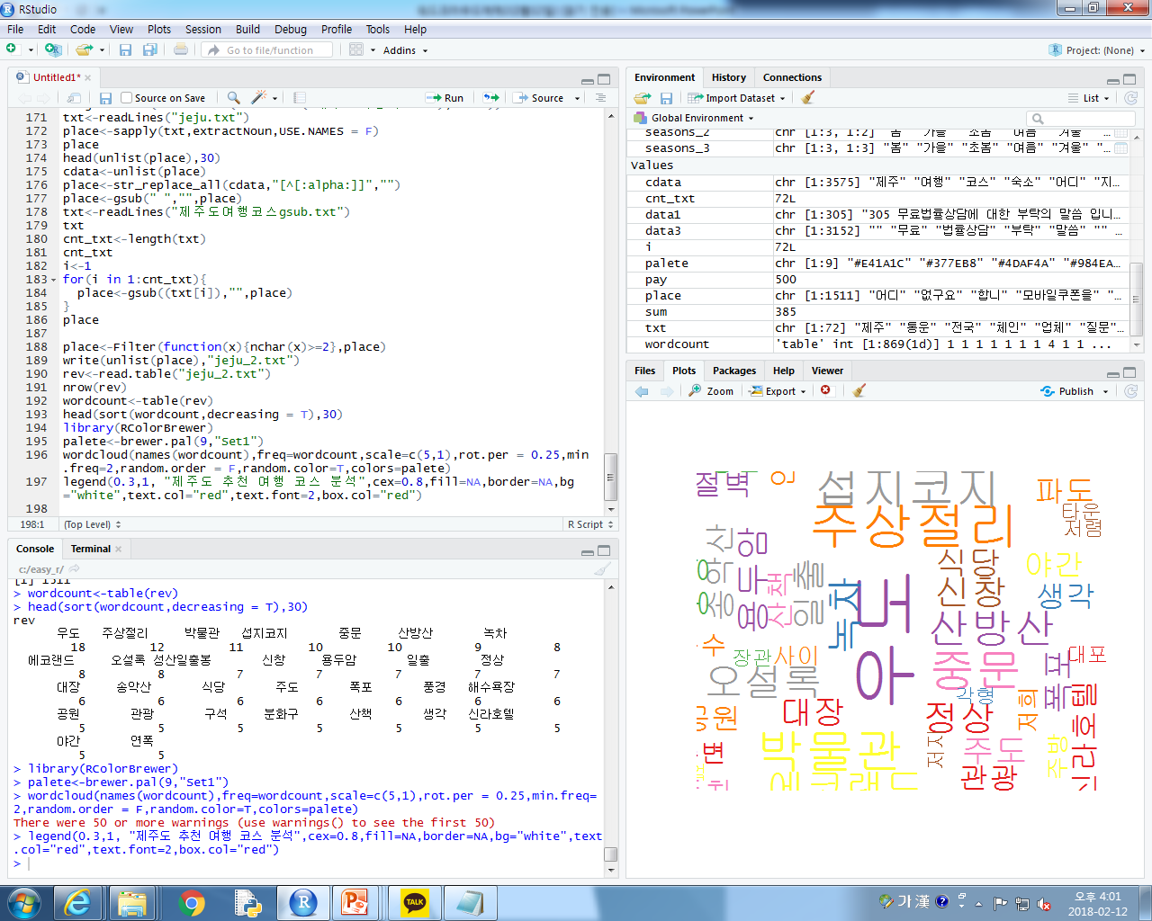
제주도 여행지 wordcloud
Notes:
setwd("c:\\easy_r")
install.packages("KoNLP")
install.packages("wordcloud")
install.packages("stringr")
library(KoNLP)
library(wordcloud)
library(stringr)
useSejongDic()
mergeUserDic(data.frame(readLines("제주도여행지.txt"),"ncn"))
txt<-readLines("jeju.txt")
place<-sapply(txt,extractNoun,USE.NAMES = F)
place
head(unlist(place),30)
cdata<-unlist(place)
place<-str_replace_all(cdata,"[^[:alpha:]]","")
place<-gsub(" ","",place)
txt<-readLines("제주도여행코스gsub.txt")
txt
cnt_txt<-length(txt)
cnt_txt
i<-1
for(i in 1:cnt_txt){
place<-gsub((txt[i]),"",place)
}
place
place<-Filter(function(x){nchar(x)>=2},place)
write(unlist(place),"jeju_2.txt")
rev<-read.table("jeju_2.txt")
nrow(rev)
wordcount<-table(rev)
head(sort(wordcount,decreasing = T),30)
library(RColorBrewer)
palete<-brewer.pal(9,"Set1")
wordcloud(names(wordcount),freq=wordcount,scale=c(5,1),rot.per = 0.25,min.freq=2,random.order = F,random.color=T,colors=palete)
legend(0.3,1, "제주도 추천 여행 코스 분석",cex=0.8,fill=NA,border=NA,bg="white",text.col="red",text.font=2,box.col="red")

Slide 10
성형수술 wordcloud
setwd("c:\\easy_r")
install.packages("KoNLP")
install.packages("wordcloud")
install.packages("stringr")
library(KoNLP)
library(wordcloud)
library(stringr)
useSejongDic()
txt<-readLines("remake2.txt")
place<-sapply(txt,extractNoun,USE.NAMES = F)
place
head(unlist(place),30)
cdata<-unlist(place)
place<-str_replace_all(cdata,"[^[:alpha:]]","")
place<-gsub(" ","",place)
txt<-readLines("성형부작용gsub.txt")
txt
cnt_txt<-length(txt)
cnt_txt
i<-1
for(i in 1:cnt_txt){
place<-gsub((txt[i]),"",place)
}
place
place<-Filter(function(x){nchar(x)>=2},place)
write(unlist(place),"remake2_2.txt")
rev<-read.table("remake2_2.txt")
nrow(rev)
wordcount<-table(rev)
head(sort(wordcount,decreasing = T),30)
library(RColorBrewer)
palete<-brewer.pal(9,"Set1")
wordcloud(names(wordcount),freq=wordcount,scale=c(5,1),rot.per = 0.25,min.freq=2,random.order = F,random.color=T,colors=palete)
legend(0.3,1, "성형 부작용1",cex=0.8,fill=NA,border=NA,bg="white",text.col="red",text.font=2,box.col="red")
Notes:
setwd("c:\\easy_r")
install.packages("KoNLP")
install.packages("wordcloud")
install.packages("stringr")
library(KoNLP)
library(wordcloud)
library(stringr)
useSejongDic()
txt<-readLines("remake2.txt")
place<-sapply(txt,extractNoun,USE.NAMES = F)
place
head(unlist(place),30)
cdata<-unlist(place)
place<-str_replace_all(cdata,"[^[:alpha:]]","")
place<-gsub(" ","",place)
txt<-readLines("성형부작용gsub.txt")
txt
cnt_txt<-length(txt)
cnt_txt
i<-1
for(i in 1:cnt_txt){
place<-gsub((txt[i]),"",place)
}
place
place<-Filter(function(x){nchar(x)>=2},place)
write(unlist(place),"remake2_2.txt")
rev<-read.table("remake2_2.txt")
nrow(rev)
wordcount<-table(rev)
head(sort(wordcount,decreasing = T),30)
library(RColorBrewer)
palete<-brewer.pal(9,"Set1")
wordcloud(names(wordcount),freq=wordcount,scale=c(5,1),rot.per = 0.25,min.freq=2,random.order = F,random.color=T,colors=palete)
legend(0.3,1, "성형 부작용1",cex=0.8,fill=NA,border=NA,bg="white",text.col="red",text.font=2,box.col="red")

Slide 11
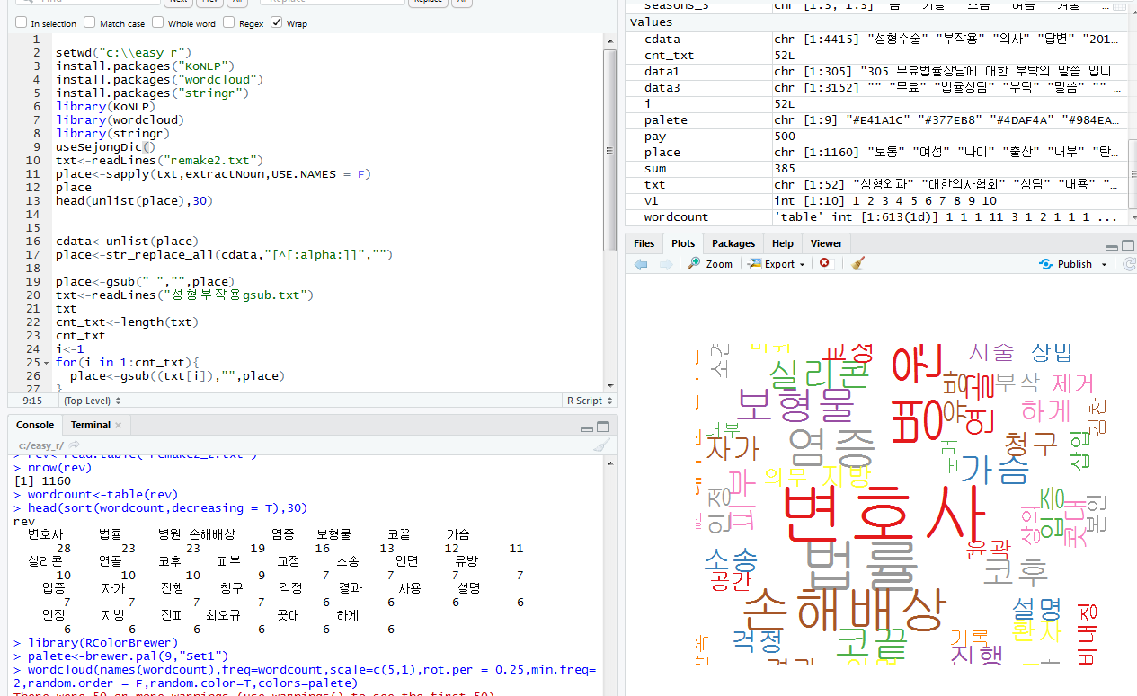
성형수술 wordcloud

